Slide 1
Sales Predictions for
Groceries and Supermarkets
How can we improve our sales?
A presentation by Mandy Sachs

Slide 2
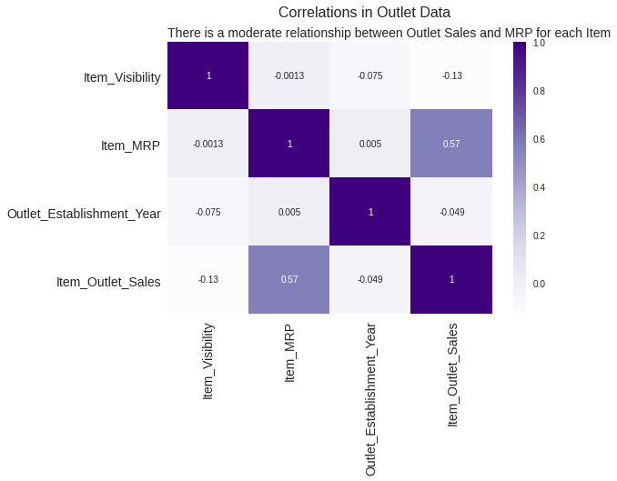
Correlations of our data
A correlation of 0.57 indicates a moderate strength relationship between Item_MRP and Item_Outlet_Sales

Slide 3
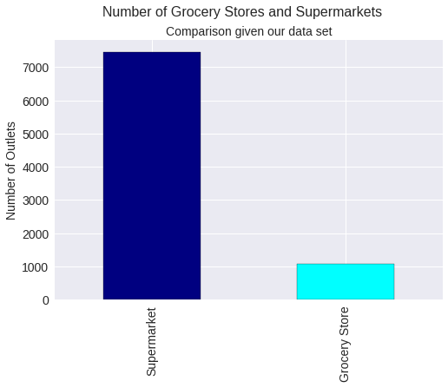
Outlet Types and Sales
Grocery Stores & Supermarkets
Our data set has much more supermarket data available

Slide 4
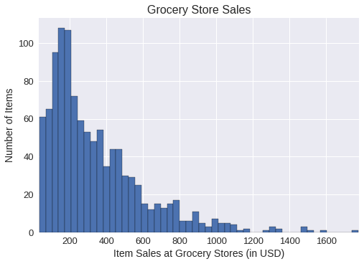
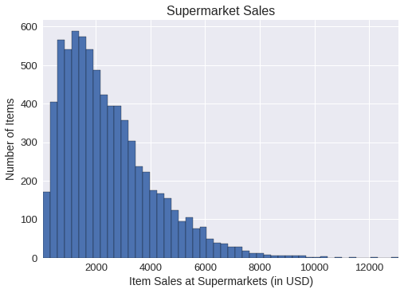
Outlet Types and Sales
Grocery Stores
Supermarkets
Both grocery stores and supermarkets have a majority of their sales per item in lower brackets

Slide 5
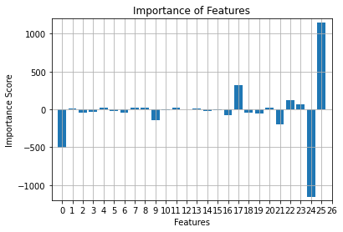
Which features are most important to our Item_Outlet_Sales?
Feature Legend
Feature 0: Item_Visibility Feature 1: Item_MRP Feature 2: Outlet_Establishment_Year Feature 3: Item_Fat_Content_Low Fat Feature 4: Item_Fat_Content_Regular Feature 5: Item_Type_Baking Goods Feature 6: Item_Type_Breads Feature 7: Item_Type_Breakfast Feature 8: Item_Type_Canned Feature 9: Item_Type_Dairy Feature 10: Item_Type_Frozen Foods Feature 11: Item_Type_Fruits and Vegetables Feature 12: Item_Type_Hard Drinks Feature 13: Item_Type_Health and Hygiene Feature 14: Item_Type_Household Feature 15: Item_Type_Meat Feature 16: Item_Type_Others Feature 17: Item_Type_Seafood Feature 18: Item_Type_Snack Foods Feature 19: Item_Type_Soft Drinks Feature 20: Item_Type_Starchy Foods Feature 21: Oulet_Location_Type_Tier 1 Feature 22: Oulet_Location_Type_Tier 2 Feature 23: Oulet_Location_Type_Tier 3 Feature 24: Oulet_Type_Grocery Store Feature 25: Oulet_Type_Supermarket
Most important features (in order of magnitude): 25, 24(-), 0(-), 17, 21(-), 9(-), 22, 23

Slide 6
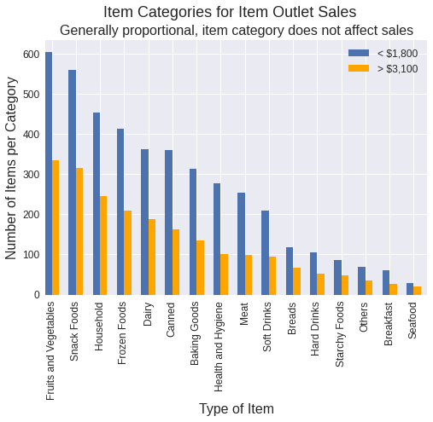
HOWEVER, upon looking at seafood…. Proportionally more items have a higher Item_Outlet_Sales

Slide 7
Linear Models and Decision Trees
Linear Regression
R² score
Train: 0.5264424685603024
Test: 0.5183542888366527
RMSE
Train: 1183.838053891126
Test: 1152.7573803143312
Simple Tree
R² score
Train: 0.6039254897160836
Test: 0.6039254897160836
RMSE
Train: 1082.6656773340972
Test: 1057.3947626960721
Bagged Trees
R² score
Training: 0.9393579272736498
Test: 0.55099315926325
RMSE
Train: 423.6360797480683
Test: 1113.0137805357635
Random Forests
R² score
Train: 0.6104682601982897
Test: 0.6026003233209926
RMSE
Train: 1073.6861410348588
Test: 1047.0991749300013

Slide 8
Random Forest
Suggested model type for this data

Slide 9
Recommendations and summaries for better profits
Focus on supermarkets vs. groceries
Proper visibility of items
Competitive prices for items and/or periodic sales
Focus on Tier 2 Outlets
Avoid Tier 1
Seafood is a profitable market
Dairy less so

